Slide 1
Autoreduction setup forms
Mathieu Doucet
Oak Ridge National Laboratory

Slide 2
Plan for the next few weeks
Test environment:
New RHEL8 machines are being set up so we can install them together
Topics to cover:
General overview
Workflow manager and DASMON listener – Installation & maintenance [this presentation]
Web monitor – Installation and maintenance
Autoreduction service – Installation and maintenance
Autoreduction setup through webmon
The IHC call – when things go wrong & recovery strategies
Vision for the future – what I would do differently

Slide 3
Post-Processing Architecture
ActiveMQ message
direct access
Translation Service
workflowmgr.sns.gov
Owned by DAS
webmon.sns.gov
announces new file
Workflow Manager
Web Monitor
Runs script that can be changed by IS
autoreducer[1-4].sns.gov
Post Processing
instructions & status
Users love this
heartbeat
heartbeat
DASMON
DASMON Listener
PostgreSQL Database
Owned by DAS
Local to instrument
All involved would like to see it go.
Known issue: DAS GL doesn’t like that a tool not owned by DAS report on DAS
heartbeat, status
PV updates
workflowdb2.sns.gov
pvsd
heartbeat
AMQ broker
+ PostgreSQL
livedata.sns.gov
Plot server
amqbroker[1-2].sns.gov

Slide 4
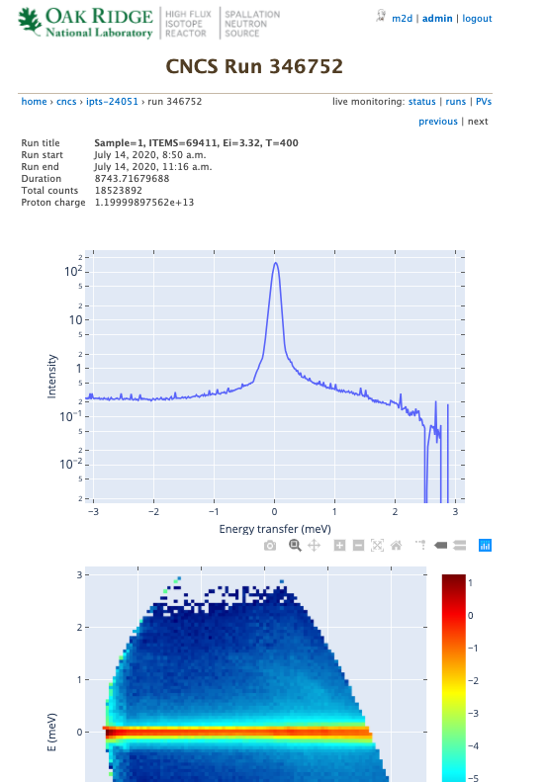
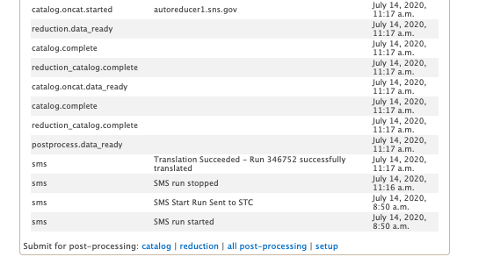
Setup accessible through web monitor
The code is in data_workflow/reporting/reduction
User submits form
Most recent parameter values are stored in the DB
Form allows user to see/modify parameters
Process form
Store new values in DB
Compose json payload
Write script
AR service receives request
Template is used to generate script
Submit request to AR through AMQ
/SNS/CNCS/shared/autoreduce/reduce_CNCS.py.template

Slide 5
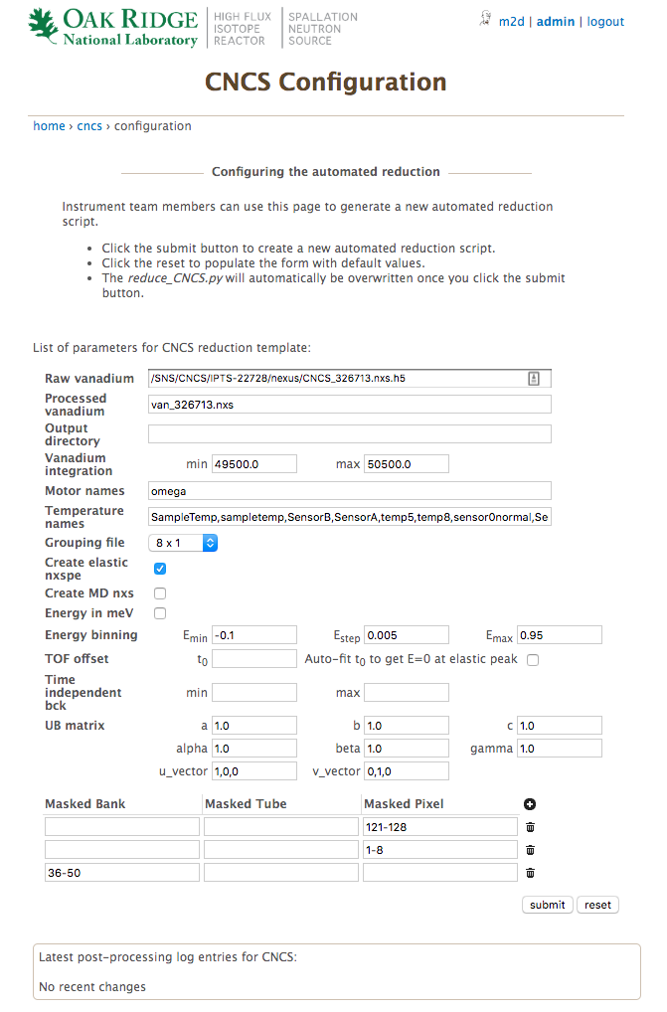
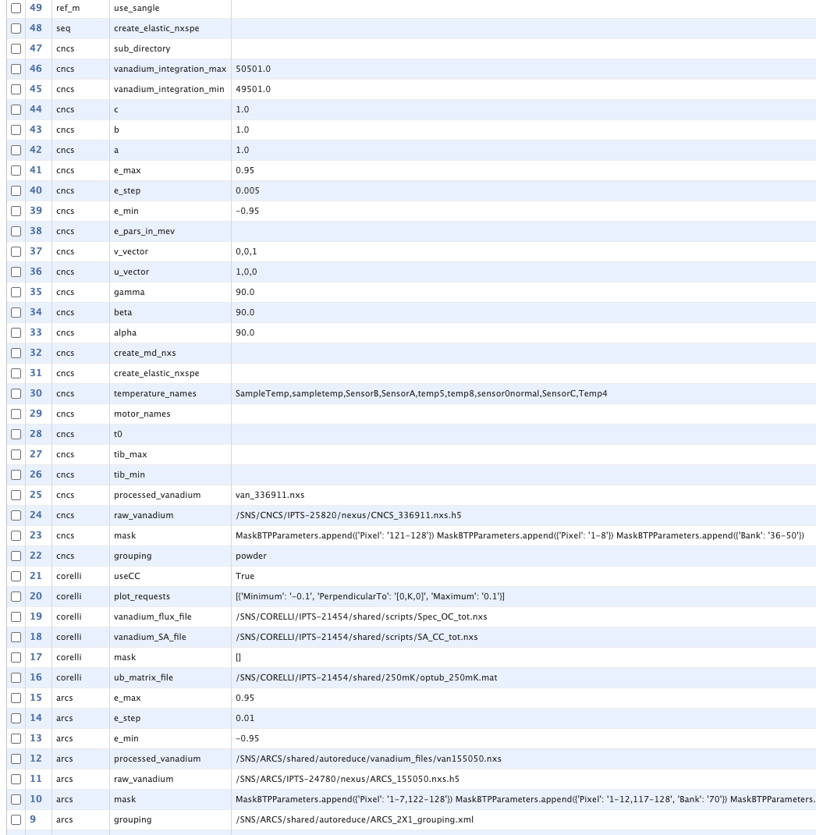
The setup form
https://monitor.sns.gov/reduction/cncs/
Code is in data_workflow/reporting/reduction/forms.py
Inherit from a common base class BaseReductionConfigurationForm
Values are stored as ReductionProperty model objects
New params can be added to the form and will be created in the DB automatically
An html template also needs to be modified:
data_workflow/reporting/templates/reduction/configuration_cncs.html

Slide 6
Example form
Uses standard Django fields
List of fields used in the template
If you need to populate drop-downs according to instrument, or initialize fields dynamically, do it here

Slide 7
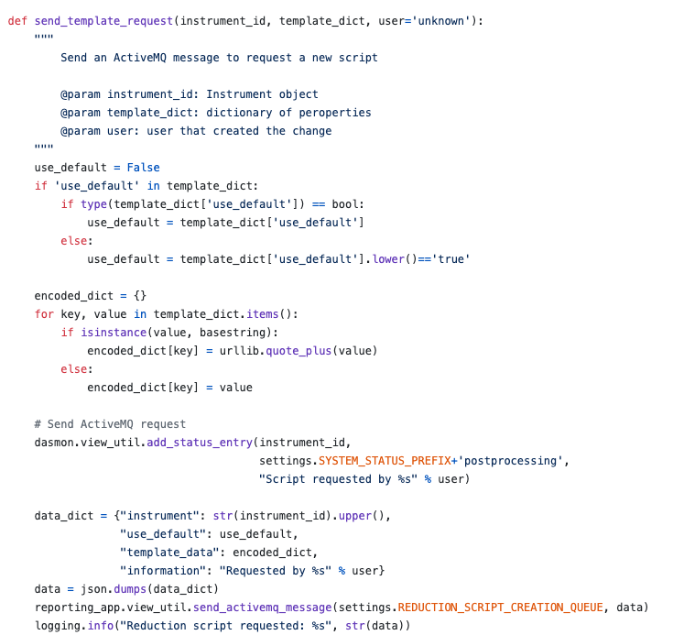
The AMQ message
data_workflow/reporting/reduction/view_utils.py
The code executing the job is part of the post_processing_agent:
postprocessing/reduction_script_writer.py
The web monitor doesn’t have access to the file system, but the AR service does…

Slide 8
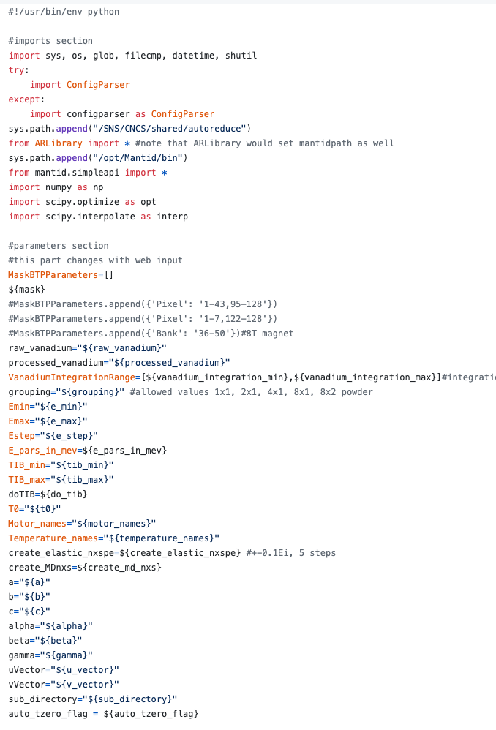
The template
Template resides in the instrument’s shared area
It can be modified by the instrument team
Replace keys with values

